Slide 1


Delivering easy-to-use frameworks to empower data-driven research
Dr. Rosa Filgueira, University of Edinburgh, EPCC

Slide 2
Background
PhD Computer Science – Madrid/Carlos III
Dynamic optimization techniques (reducing overhead in IO and communication systems) to enhance performance of MPI-based applications
5 years as a Postdoc – University of Edinburgh/DIR group
2 years as a Senior Data scientist at BGS
Currently – EPCC at the University of Edinburgh
Data Architect activities across different domains/ Projects/
Scalability and performance of applications executed on HPC and Cloud resources
Scientific workflows, data-frameworks, containers and reproducibility tools, etc.
Research activities – New data-driven frameworks to develop data-intensive applications that run in heterogenous systems
https://www.rosafilgueira.com/

Slide 3
Introduction
Big Data Sciences Era, Data Intensive Computing applications
Scientific fields →
Data-driven
Astronomy, Geosciences, Meteorology, Bioinformatics
Common points
Big complex data sets
Need to be analysed
Numerous software tools
Data transformation and visualisation
Notes:
Many scientific fields have become highly data-driven with the development of computer sciences. For instance the scientific discovery in, astronomy, meteorology, social computing, bioinformatics are very often as a results of data intensive analyses on large volume of data produces in these science fields. Several common point exist in these disciplines which are that they generate big complex data sets which usually need to be analysed, generally requiring numerous software tools, tied together in successive stages of data transformation and visualisation.

Slide 4
Data analytic frameworks and Computing environments
Introduction
Big Data Sciences Era, Data Intensive Computing applications
Automatically handle large amount of data
Computational steps:
Speed
Scalability
Flexibility
Robustly
Notes:
Usingdata analytic frameworks and High-Performance Computing (HPC)/Cloud computing environments can simplify the effort required for these analyses, since they can handle automatically large amount of data as well all the computational steps robustly, with speed, scalability, and flexibility, which is vital for many science domains.

Slide 5
Delivering easy-to-use frameworks to empower data-driven research
Seismology
Scientific Workflows:
dispel4py
Pegasus
CWL
Computing environments:
HPC Clusters
Cloud
Notes:
In this talk I will give two examples, one from Seismlogy, for which we have used different Scientific workflows for building the analytics applications and executed them on different HPC resources and Cloud systems

Slide 6




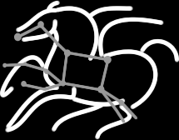
Why Scientific Workflows ?
General Features
Abstraction, scientists can focus on their research and not computation management
Automate
Easy composition and execution
Enables parallel, distributed computations
Recover
Different types
abstract vs. concrete
task-flow vs. data-flow
files vs. stream-based
Debug
Workflow Management Systems (WMS)
Provide tools to generate the scientific workflow

Slide 7




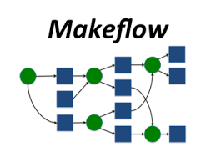

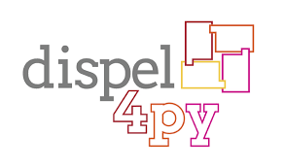


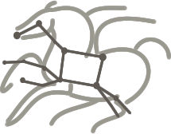

WORKFLOW MANAGEMENT SYSTEMS
Taverna
https://taverna.incubator.apache.org
KNIME
https://www.knime.org
Kepler
https://kepler-project.org
VisTrails
http://vistrails.org
Makeflow
http://ccl.cse.nd.edu/software/makeflow
FireWorks
https://pythonhosted.org/FireWorks
dispel4py
http://dispel4py.org
Swift
http://swift-lang.org
Nextflow
https://www.nextflow.io
Pegasus
http://pegasus.isi.edu
<<<
Common Workflow Language
https://www.commonwl.org

Slide 8

Asterism Framework
Easy to understood, platform-independent, open-source
Simplifies the development applications running across multiple heterogeneous
How ?
Traditional WMS
Pegasus
Ewa Deelman, ISI-USC,US
Rafael Ferreira da Silva, ISI-USC, US
Combining the strengths of
New stream-based data-flow systems
dispel4py
Rosa Filgueira, EPCC-UoE, UK
Amrey Krause, EPCC-UoE, UK
Malcolm Atkinson, Informatics-UoE, UK

Slide 9
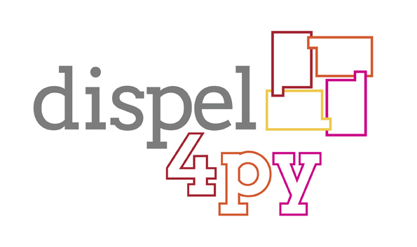
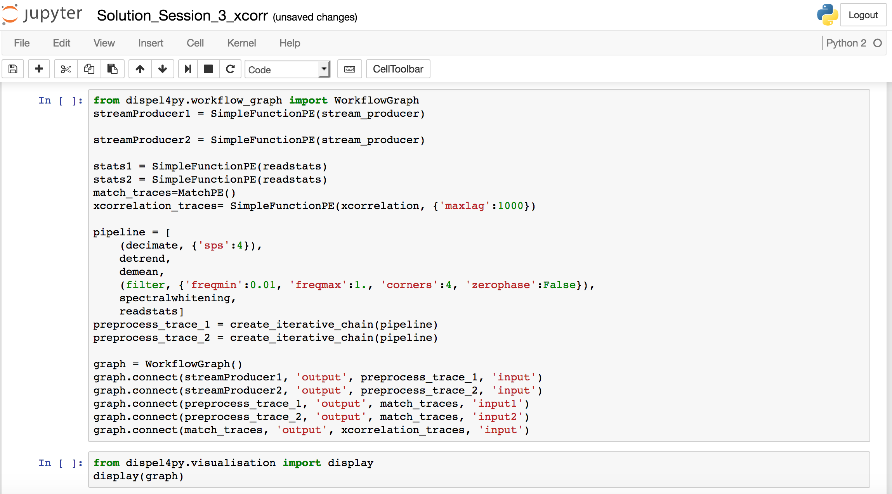

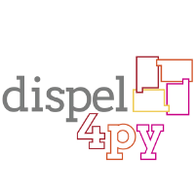

dispel4py parallel stream-based dataflow system
dispel4py
Automation
Workflow Composition
Automates pipeline executions
Concurrent, distributed computations
Stream-based model
Python Library
Groupings
Jupyter
High-level stream-based data pipeline
~ Apache Beam
Mapping
Sequential
Multiprocessing
MPI
Apache Storm
Apache Spark (Prototype)
Optimisation
Multiple streams
Avoids I/O operations
Key-features: Automatic mappings to different engines, concurrent & stream-based
https://github.com/dispel4py/dispel4py
Notes:
.

Slide 10
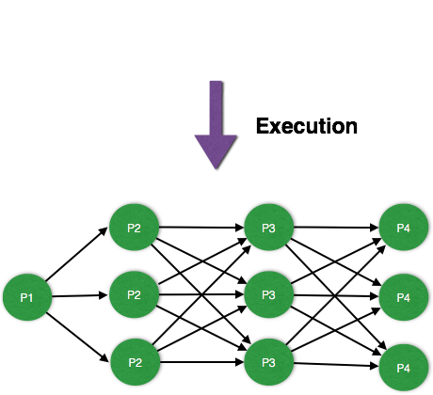
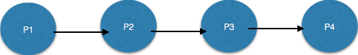
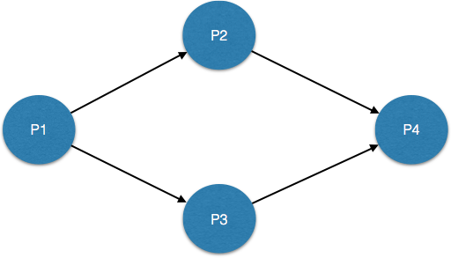
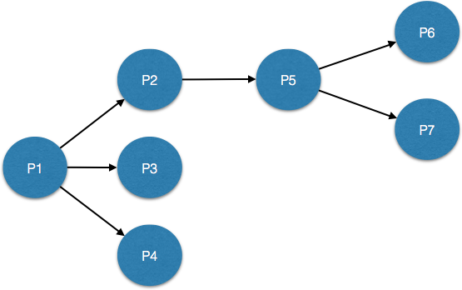

dispel4py parallel stream-based dataflow system
Graph
Connections among PES
Abstract workflow
Instance
Each PE is translated into one or more instances in run-time
Each instance runs in a process
dispel4py does it for you
Concrete workflow
Example of graphs
Pipeline
Split & Merge
a
a
a
a
b
b
b
c
c
c
Tree
4 PEs & 10 processes
Notes:
A graph represents the topology of the workflow. And actually, it is what users have to think when they build a dispel4py workflow. And there is not limitations in the type of graph that we can do with dispel4py, we can do pipelines, split & merge, trees/ Behind the scenes, dispel4py translates the user graphs into another type of graph that are executed. Each PE is copied into one or several instances that runs in a process. For example, lets imagine that a user has create the pipeline graph, and he/she wants to execute it with 10 processes, … So, dispel4py creates automatically ( by default), several copies of the Pes, and they are connected following here a round-robin communication pattern.

Slide 11

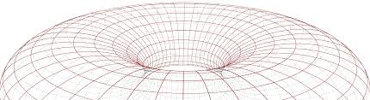
Pegasus workflow system
Automation
Automates pipeline executions
Parallel, distributed computations
Automatically executes data transfers
Heterogeneous resources
Task-oriented model
Application is seen as a black box
Debugging
Workflow execution and job performance metrics
Real-time monitoring, graphs, provenance
Recovery
Optimisation
Job failure detection
Checkpoint Files
Job Retry
Rescue DAGs
Job clustering
Data cleanup
LIGO project:
First detection of gravitational waves from colliding black holes
Key-features: Automatic data movement, cleanup, heterogeneous & coordination
http://pegasus.isi.edu

Slide 12


Complementary systems
files
streams
t1
Pe1
t2
t3
t4
Pe2
Pe3
Pe4
parallelism
concurrency
t5
Pe5
heterogeneous
execution
homogeneous
execution
t6
Pe6
Task-flow
Data-flow
Task: Executable (black box)
Processing Elements: python objects

Slide 13
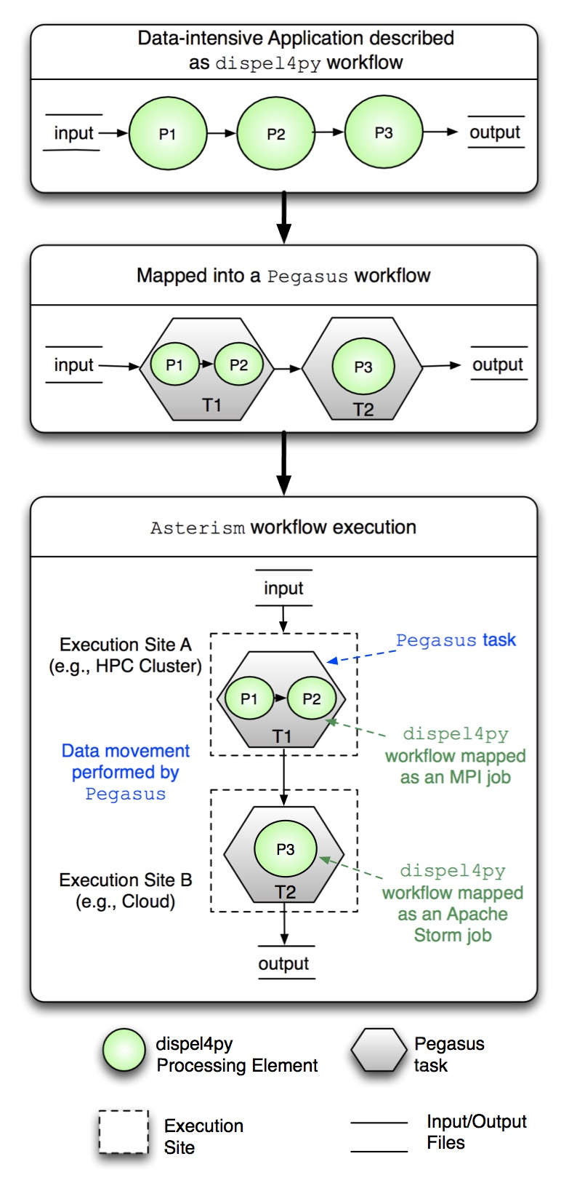
+
dispel4py to represent different
parts of applications
Pegasus to distribute and execute
each dispel4py workflow
Pegasus
ASTERISM

Slide 14

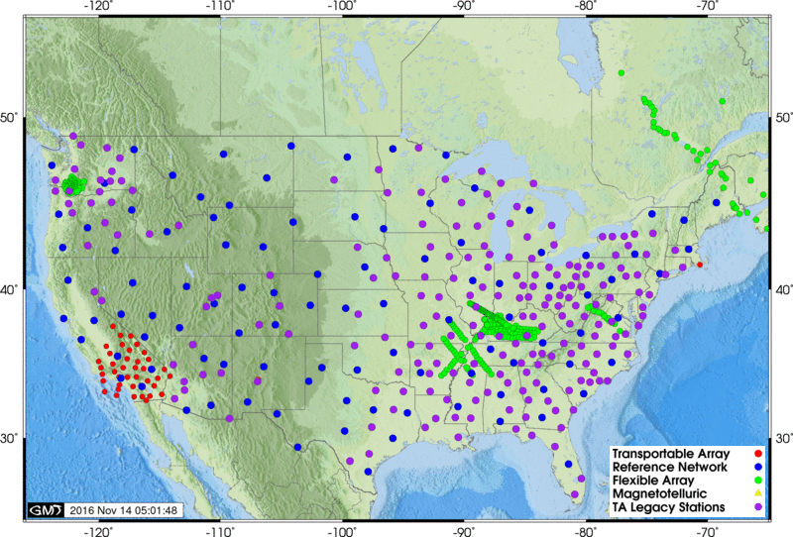
Seismic Ambient Noise Cross-Correlation
Data intensive problem and it is commonly used in seismology research
Seismic Noise: Permanent motion of the Earth surface
that is not related to earthquakes or specific controlled sources.
Noise correlation functions: results of application
of cross-correlation operator to continuous
seismic records at pairs of recorders.
VERCE delivers a productive e-Science environment for seismology research
Notes:
data intensive problem and it is commonly used in seismology research

Slide 15
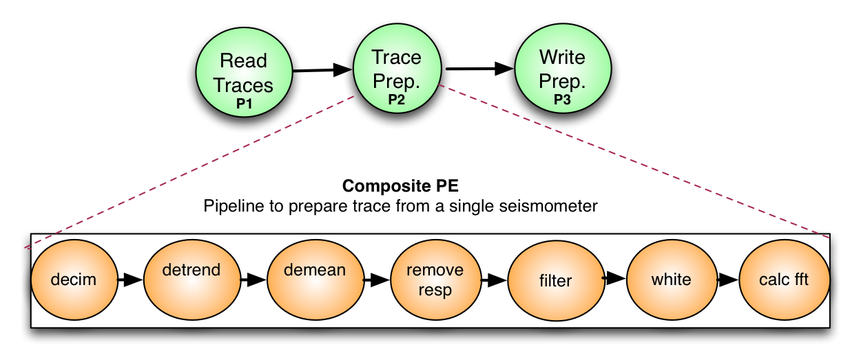
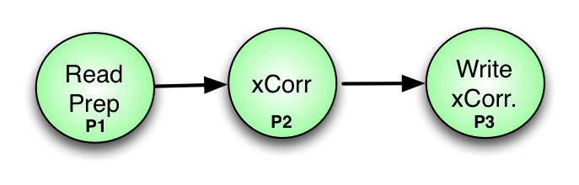
Seismic Ambient Noise Cross-Correlation
Phase 1
dispel4py workflow
IRIS USA TA array – 1000 stations- 4999500 cross-correlations per hour
Preprocesses (Phase 1) and cross-correlates traces (Phase 2) from multiple seismic stations
Phase 2
dispel4py workflow
VERCE project both phases on the same HPC resource.
Notes:
data intensive problem and it is commonly used in seismology research

Slide 16

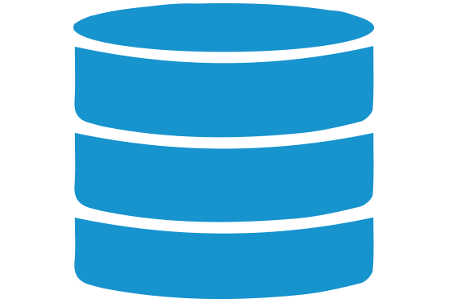
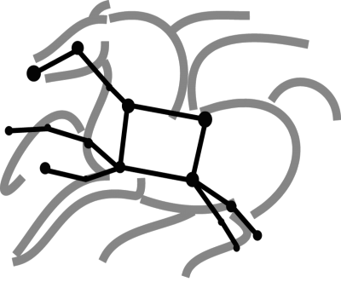
Evaluation- Seismic Ambient Noise Cross-Correlation
input data (~150MB)
Execution among
heterogeneous systems
MPI Cluster
IRIS database
(1000 stations)
Phase 1
data transfers between sites performed by Pegasus
Phase 2
Submit host
Storm Cluster
(e.g., user’s laptop)
output data (~40GB)
Notes:
So, we decided to use this use case for testing Asterism.
So, we want to use a laptop/desktop to submit both phase 1 and phase 2 workflows, and execute the phase 1 workflow in an MPI cluster and execute the second one in a Storm cluster. And use as an input data, 1000 station from IRIS website

Slide 17

Evaluation- Seismic Ambient Noise Cross-Correlation
input data (~150MB)
NSF-Chamelon Cloud
Allocation: 40 instances
Container 2
MPI Cluster
IRIS database
(stations)
Phase 1
data transfers between sites performed by Pegasus
Phase 2
Container 1
Submit host
Storm Cluster
output data (~40GB)
Container 3
https://github.com/dispel4py/pegasus_dispel4py

Slide 18
Reminder
Data-Intensive Application
dispel4py preproc. (Phase 1)
dispel4py proc. (Phase 2)
Container 2
NSF-Chamelon cloud
1 node – 40 cores
MPI Cluster
Phase 1
Container 1
Submit
Site
Storm Cluster
Phase2
Container 3
Dockerfiles to configure containers images → Stored in our GitHub → Linked to DockerHub → stored/share/download images

Slide 19
Reminder
Data-Intensive Application
1 instance as
Container 1
dispel4py preproc. (Phase 1)
dispel4py proc. (Phase 2)
Container 2
NSF-Chamelon cloud
1 node – 40 cores
MPI Cluster
Container 1
Submit
Asterism
Storm Cluster
Container 3
Dockerfiles to configure containers images → Stored in our GitHub → Linked to DockerHub → stored/share/download images

Slide 20
Reminder
Data-Intensive Application
1 instance as Container 2
(MPI head node)
16 instances as Container 2
(MPI workers)
dispel4py preproc. (Phase 1)
dispel4py proc. (Phase 2)
Container 2
NSF-Chamelon cloud
1 node – 40 cores
MPI Cluster
Container 1
Phase 1
Submit
Asterism
Storm Cluster
Container 3
Dockerfiles to configure containers images → Stored in our GitHub → Linked to DockerHub → stored/share/download images

Slide 21
Reminder
Data-Intensive Application
3 instances as Container 3
(zookeper, nimbus, Storm UI)
16 instances as Container 3 (Supervisors)
dispel4py preproc. (Phase 1)
dispel4py proc. (Phase 2)
Container 2
NSF-Chamelon cloud
1 node – 40 cores
MPI Cluster
Container 1
Phase 1
Submit
Asterism
Storm Cluster
Phase 2
Container 3
Dockerfiles to configure containers images → Stored in our GitHub → Linked to DockerHub → stored/share/download images

Slide 22
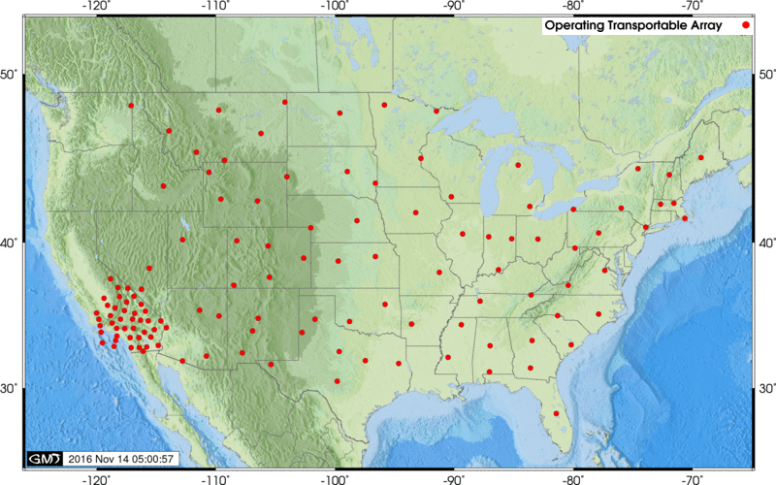
Asterism Evaluations
Experiment 1: Data from IRIS services (394 stations)
Time
Phase 1 – 8 minutes
Phase 2 – 2 hours
Moving data < 1 minute
Data size
Input data 150MB
Output data 39GB
Experiment 2: Workflow for 3 days requesting data every 2 hours
Scope of this work
Executing & paralyzing automatically data-intensive applications
in heterogeneous systems with different enactment engines
NSF-Chamelon cloud
1 node – 40 cores
Maximizing performance
- both phases in the MPI cluster
- increasing the number of Storm Supervisors
Notes:
Thus, (150 MB) performing 77421 cross-correlations (39GB) without modifying the code.

Slide 23
dispel4py Performance Evaluations
Computing Resources | Terracorrelator | SuperMuc | Amazon EC2 | EDIM1
Type | Shared-memory | Cluster | Cloud | Cloud
Enactment Systems | MPI, multi | MPI, multi | MPI, Storm, multi | MPI, Storm, multi
Nodes | 1 | 16 | 18 | 14
Cores per Node | 32 | 16 | 2 | 4
Total Cores | 32 | 256 | 36 | 14
Memory | 2TB | 32GB | 4GB | 3GB
Processor and Network
Speed are the lowest
Notes:
Because we wanted to evaluate the performance of those workflows under different platofrms with different mappings, we used the following ones.
Storm mapping was not tested on the Terracorrelator or SuperMuc as it required a Storm cluster, which is not allowed on either platform.
For popularity and freedom to adjust the enviroment we chose Amazon EC2 cloud, where MPI and Storm was installed. We use also EDIM1, as we have complete control of this computing resource and we have the same freedom as on Amazon to use Storm and MPI. However, the processor and network speed that EDIM1 offers are the lowest of all the computing resources we tried as it was designed to minimise the energy and component cost while maximasing channels to backing store per node (1 SSD and 3 HD).

Slide 24
dispel4py Performance Evaluations
Data-Intensive Application
Both workflows (Phase 1 and Phase 2) executed
in the same computing resource and the same mapping.
dispel4py preproc. (Phase 1)
Mode | Terracorrelator (32 cores/Node) | SuperMuc (256 cores 16 cores/node) | Amazon (36 cores 2 cores/node) | EDIM1 (14 cores 4 cores/node)
MPI | 1501.32 (~25minutes) | 1093.16 (~19minutes) | 16862.73 (~5hours) | 38656.94 (~11 hours)
multi | 1332 .20 (~23minutes)
Storm |  |  | 27898.89 (~8 hours) | 120077.123 (~33 hours)
dispel4py proc. (Phase 2)
1000 stations
Input 150MB
Output 39GB
Notes:
And here we have the performance results.
The performance of the mappings depends on the workflow and the platforms

Slide 25

Asterism: Easy-to-use system to empower data-driven research
New framework that automatically
manage the entire workflow, monitor its execution
handle data transfers between different platforms
map to different enactment engines at runtime
DARE (Delivering Agile Research Excellence on European e-Infrastructures)
Provide scientific communities with tools/frameworks/APIs for data-driven experiments,
and rapid prototyping
European RIs, initially of EPOS, on Earth science, and IS/ENES2, on climate.
http://project-dare.eu/

Slide 26
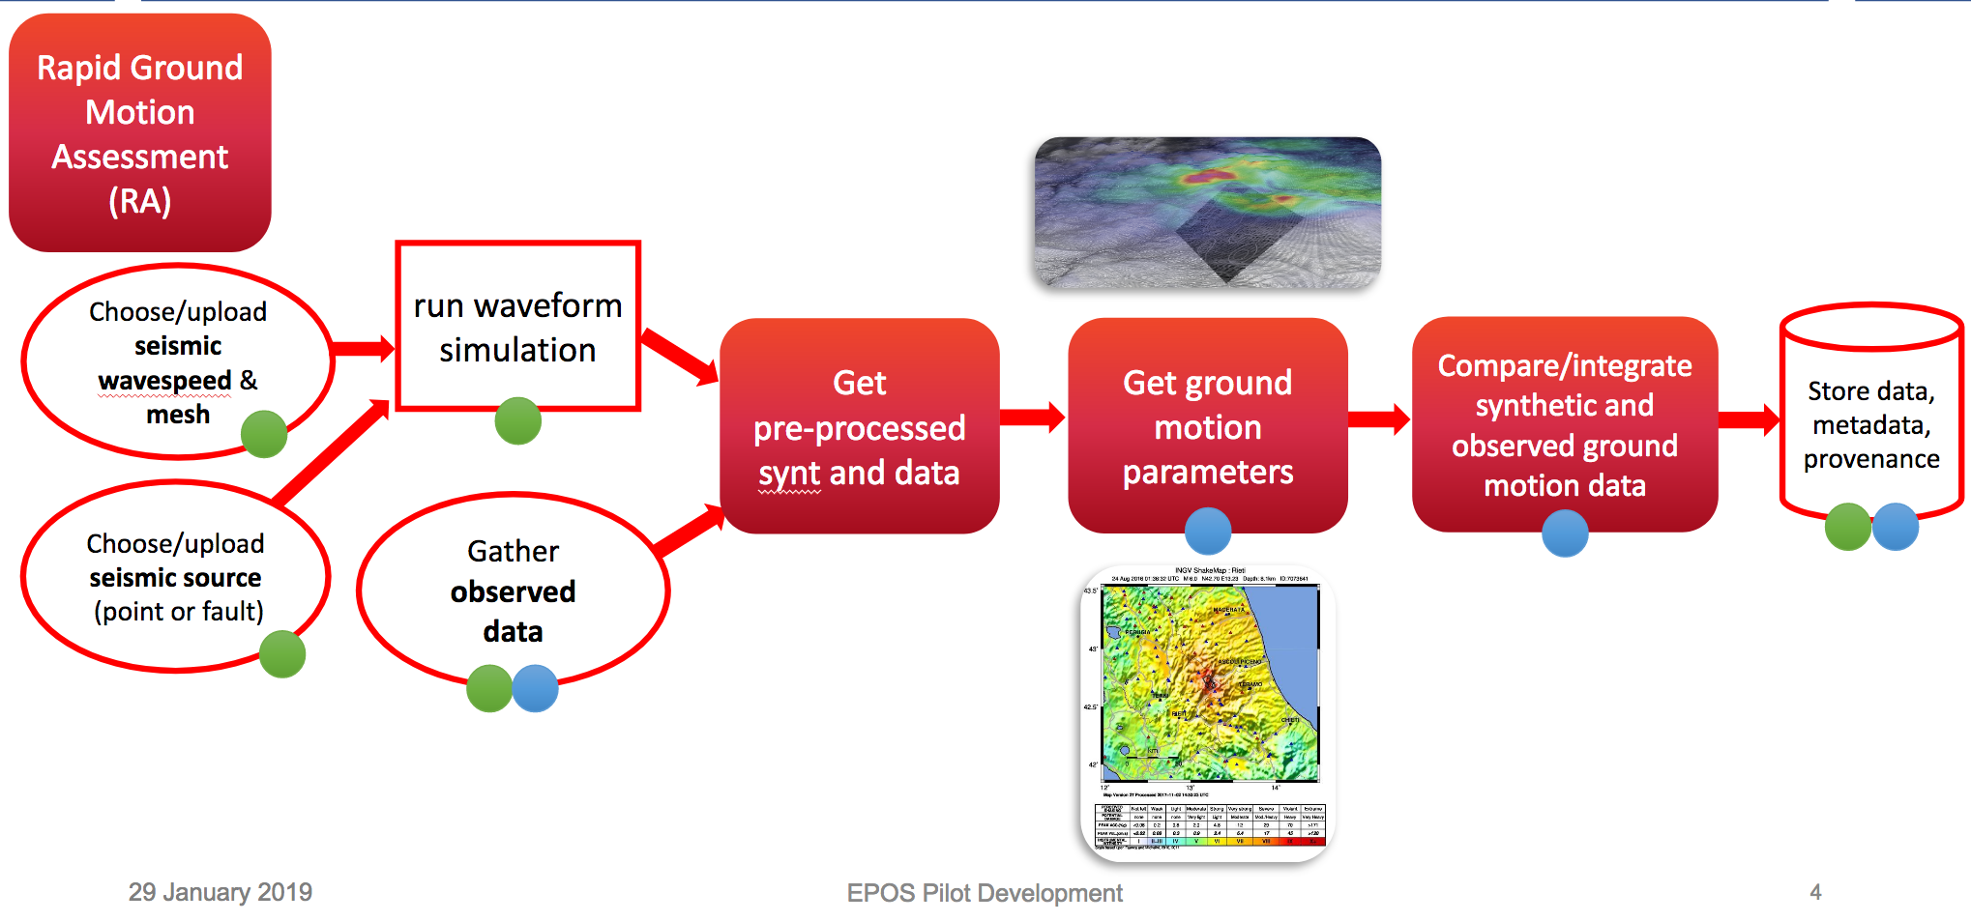
Rapid Ground Motion Assessment (RA) - EPOS
Aims:
Quickly analyse earthquakes
Model the strong ground motion after
large earthquakes
Rapid assessment of earthquakes’ impact,
and emergency response
Steps:
Build dispel4py workflows to test
them locally – using small dataset.
Scale them up:
-Run the workflows using HPC/Cloud
** Using dispel4py parallel mappings

Slide 27

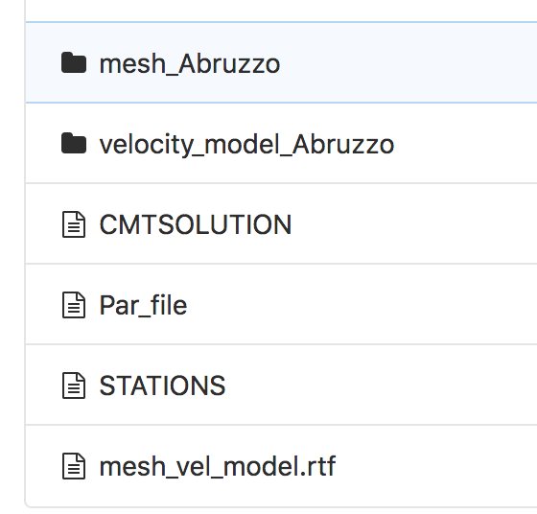
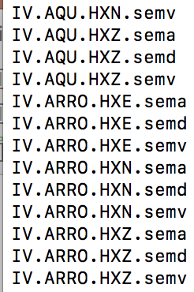
Seismic Waveform Simulation: Specfem3D + MPI cluster
We run it before
In SuperMUC -
HPC–cluster -
256 cores
>> cd specfem3D_INPUT
>> ./run_test
specfem3D
specfem3D_INPUT
MPI Cluster
DATA
-seismic source parameters that
describe the earthquake to be simulate
- models to describe the region where
the seismic wavefield is simulated
run_test.sh
OUTPUT_FILES
Test Case: RA
Virtual Machine
(Bare-metal Instance )
24 Cores
Config script to install docker, pip & python.
Clone the WP6_EPOS gitlab repo
Docker info: Alpine 3.8, OpenMPI, Specfem3D
Build the image
Copy the Specfem3D_INPUT in the container
Run the docker container

Slide 28
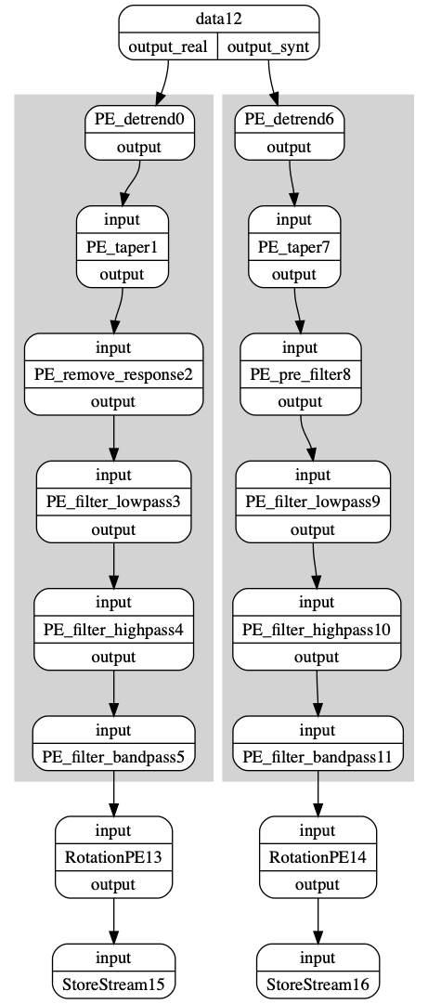
Get Pre-Preprocessed Synthetic and Data
Similar preprocessing steps
in synthetic and observed data
Test Case: RA

Slide 29
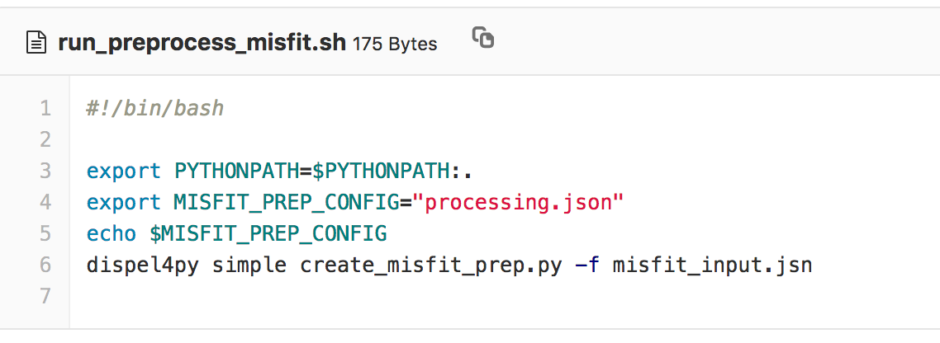
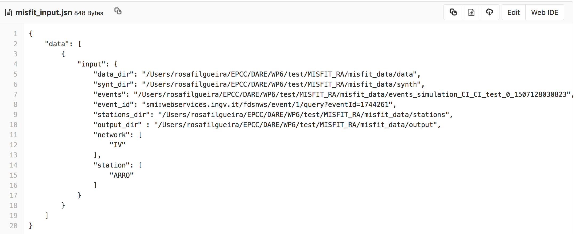
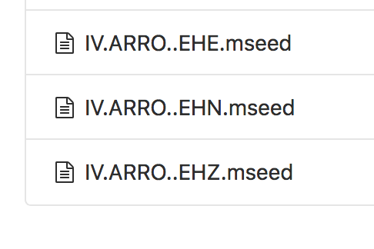
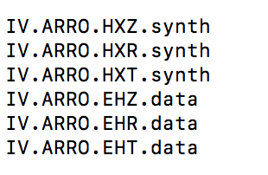
Get Pre-Preprocessed Synthetic and Data
data
synth
output
Pre-preprocessed synthetic and observed data
( Underline files are used in the next step (slide) )
Note: Those are the synth seismograms generated
in the previous step (slide)

Slide 30
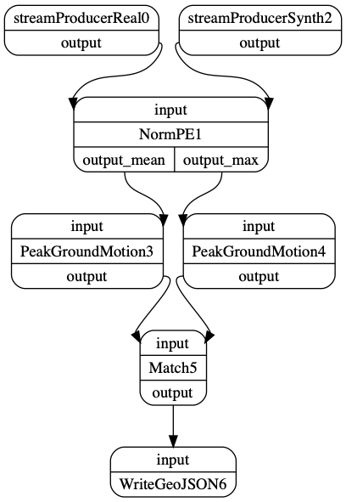
Get and Compare Ground Motion Parameters
Ground motion parameters:
Peak ground values of displacement, velocity and acceleration.
Two types of normalisation – Mean & Max
Two set of PGM outputs – Max & Mean
Test Case: RA

Slide 31
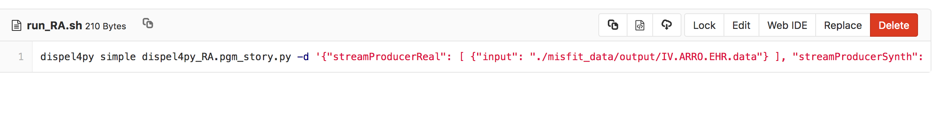
Get and Compare Ground Motion Parameters
output
output
Test Case: RA

Slide 32
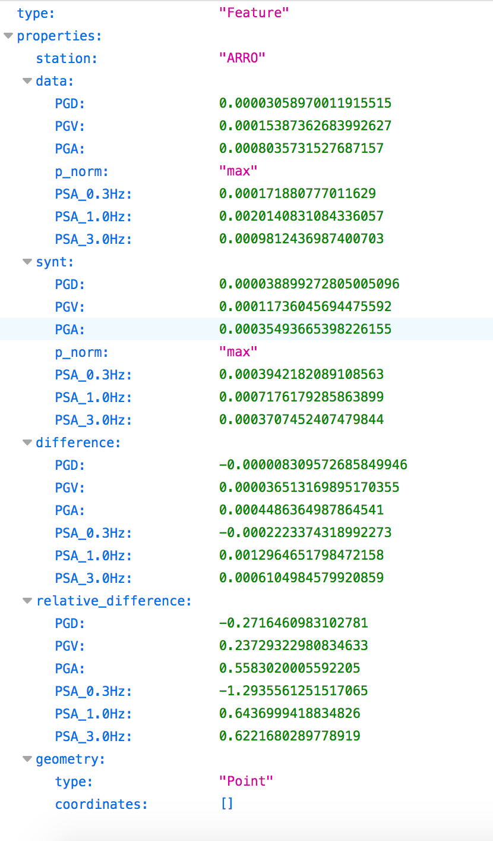
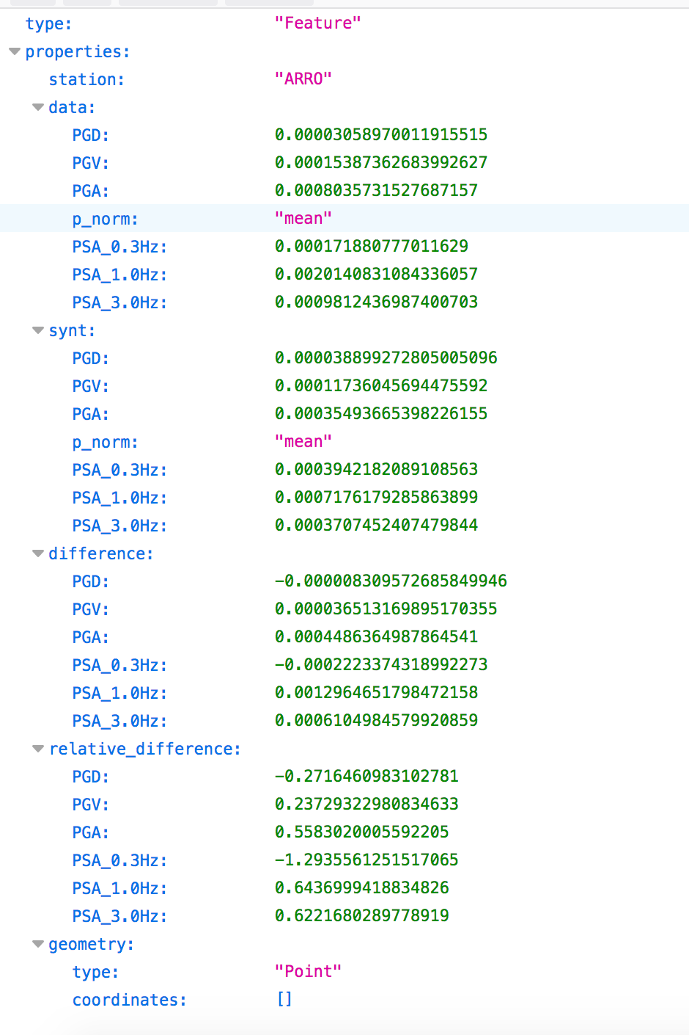
Get and Compare Ground Motion Parameters
Peak ground values of
Displacement (PGD),
Velocity (PGV)
Acceleration (PGA)
output
Test Case: RA

Slide 33
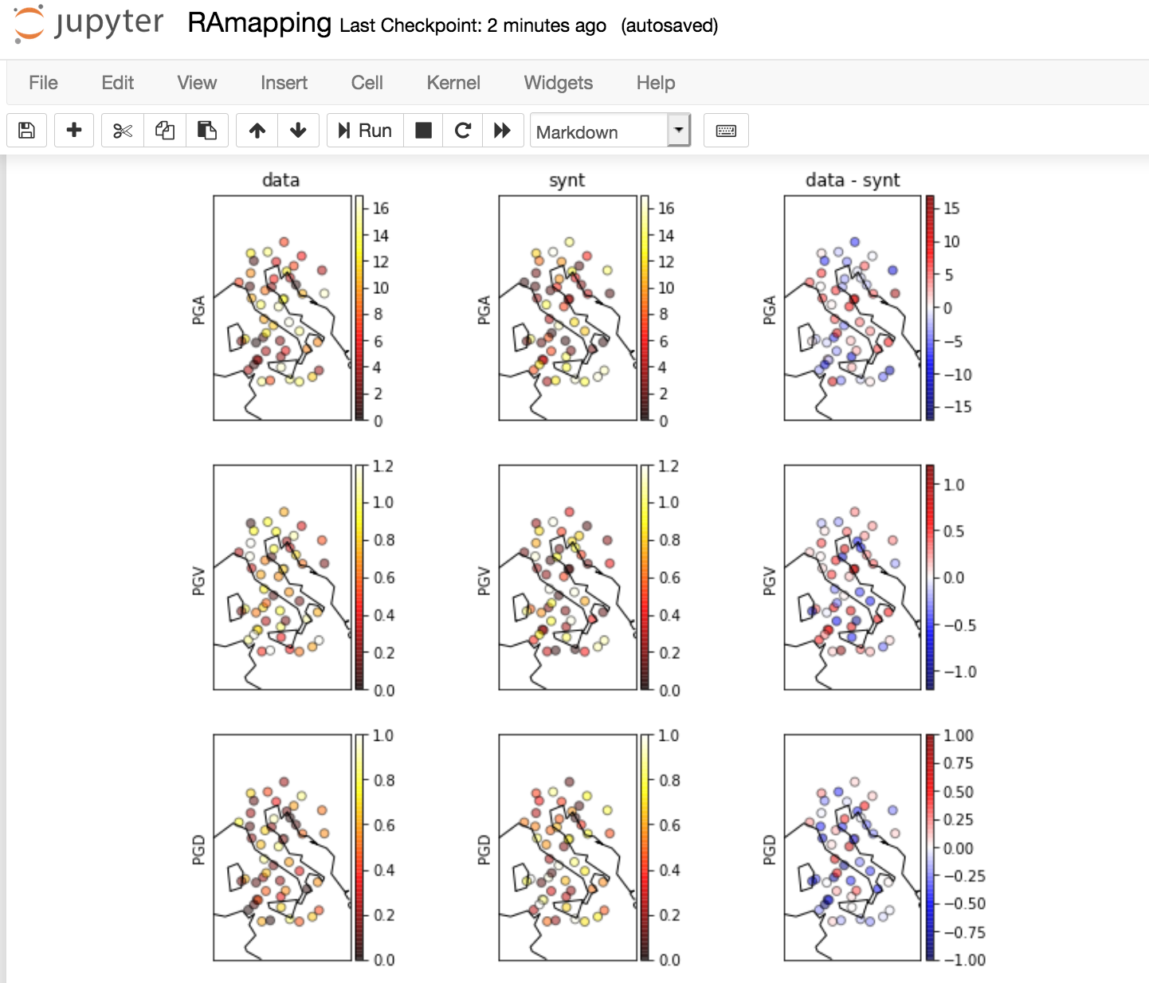
RA Maps
Waveform propagation snapshots and
maps of ground motion parameters are
fundamental for a visual representation
of the earthquake

Slide 34
Rapid Ground Motion Assessment (RA) - EPOS
dispel4py + → semantics and description
CWL is a specification for describing the
data and execution model of workflows/command tools
Provides a consistent way to connect programs

Slide 35
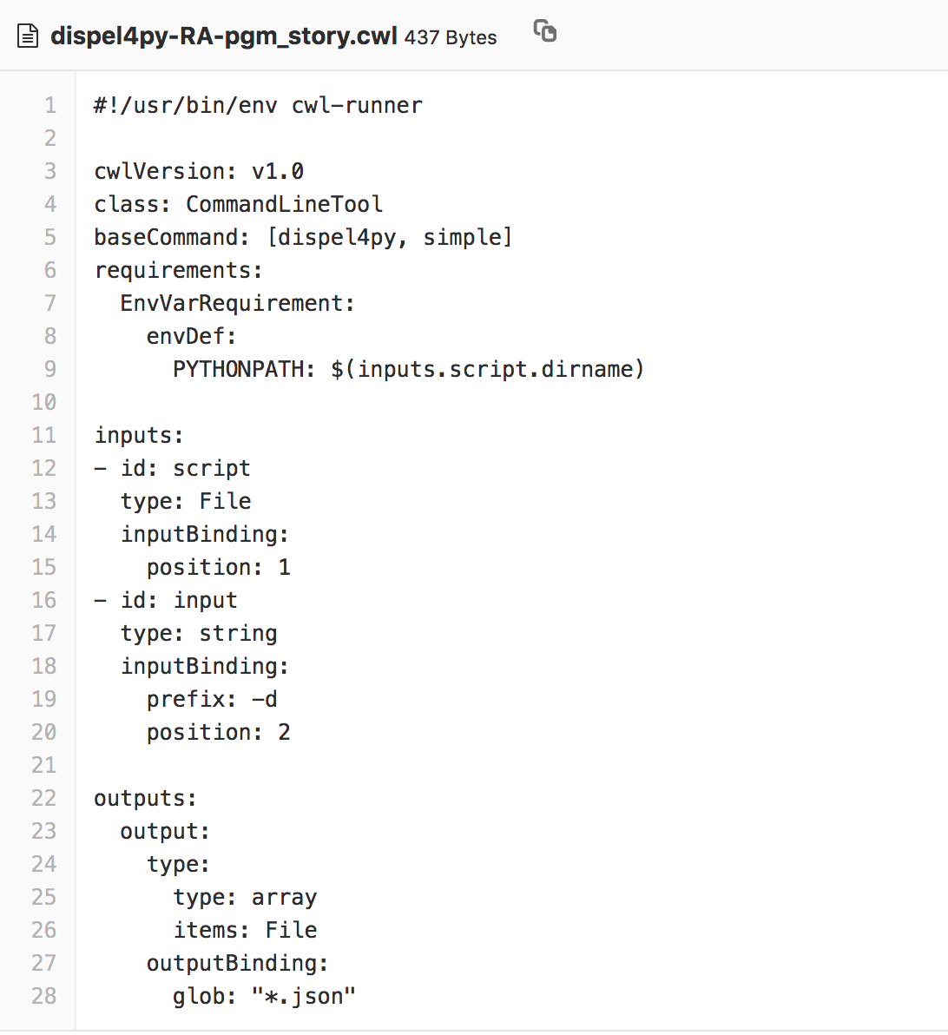
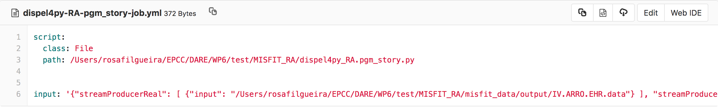
Rapid Ground Motion Assessment (RA) - EPOS
dispel4py + → semantics and description
CWL is a specification for describing the
data and execution model of workflows/command tools
Provides a consistent way to connect programs

Slide 36
Rapid Ground Motion Assessment (RA) - EPOS
Once tested all the workflows locally (seq. map),
They can be scaled up automatically → Next step.
Provenance data is also collected in runtime (optional)
Metadata, Input and Output files --> registry/catalog
Future development:
Optimization of workflows → dynamic deployment
→ mapping selection

Slide 37
Delivering easy-to-use frameworks to empower data-driven research
Dr. Rosa Filgueira, University of Edinburgh, EPCC

Slide 38
Extra Slides

Slide 39
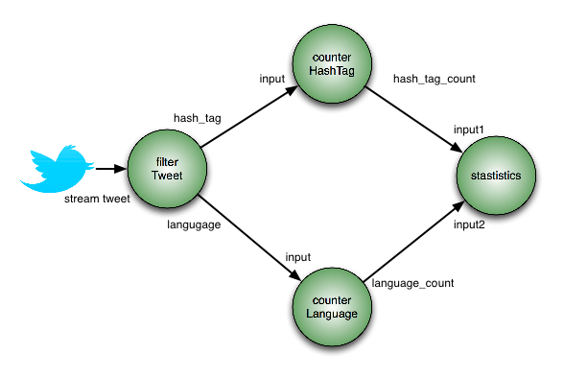
dispel4py parallel stream-based dataflow system
from dispel4py.workflow_graph import WorkflowGraph
^{pe1 = filterTweet ()}
^{pe2 = counterHashTag ()}
^{pe3 = counterLanguage ()}
^{pe4 = statistics ()}
^{graph = WorkflowGraph ( )}
graph.connect(pe1,’hash_tag’,pe2,’input’) graph.connect(pe1,’language’,pe3,’input’) graph.connect(pe2,’hash_tag_count’,pe4,’input1’) graph.connect(pe3,’language_count’,pe4,’input2’)
pe2
PEs objects
pe1
pe4
Graph
Connections
pe3
Users only have to implement:
PEs
Connections
https://github.com/dispel4py/dispel4py
Notes:
Now that I have explained the very basic dispel4py background, let me show you how easy is to create a dispel4py worklfow. So, here we have an example of a workflow which gets the number of different hash tags and language from a collection of tweets. The only thing that users need to learn is how to implement Pes and connections. Lets imagine that those 4 Pes have been implemented, so we first create the objects of those Pes, we create a graph, and then we connect the Pes as we want.

Slide 40
dispelp4y basic concepts– Example of a PE
Class filterTweet(GenericPE):
def __init__( self ): GenericPE.init (self) self.add_output(’hash_tags ’)
self.add_output(’language’)
def process ( self , inputs ):
twitterDataFile= inputs[’input ’]
tweet file = open(twitterDataFile)
for line in tweet file :
tweet = json.loads( line ) language = ’ ’ hashtags =[] language = tweet[u’lang ’].encode(’utf −8’) text = tweet[u’text ’].encode(’utf−8’) hashtags=re.findall(r”#(\w+)”, text)
self.write(‘hash tag’, hashtags)
self.write(’language’, language)
Inputs &
outputs
Logic
of PE
Users only have to implement:
PEs
Connections
Stream out
data

Slide 41
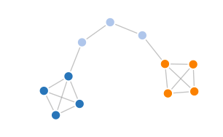
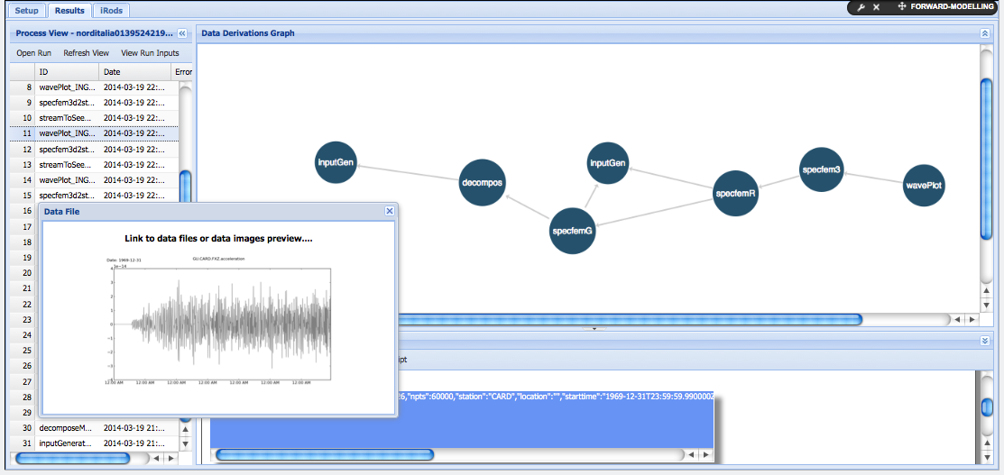

dispel4py advance concepts – Provenance
source
end
PEs
WEB api
prov
Users can select which metadata to store
Searches over products metadata within and across runs
Data download and preview
Capturing of Errors for Diagnostic purposes
Data Fabric: Multi directional navigations across data dependencies
W3C PROV-DM as reference model.
Notes:
dispel4py has been enriched with a provenance mechanism to support runtime provenance collection with selective paths and user-defined domain information, which is accessible via web API.
It supports interactive validation of results and users can choose what processed data want to store.

